Slide 1
Rusper Primary School
Handwriting Scheme - Letterjoin
www.letterjoin.co.uk

Slide 2
Why is handwriting important?
Handwriting is a basic skill that influences the quality of work throughout the curriculum
Handwriting skills are a requirement of the 2014 National Curriculum
We want our pupils to develop a neat, legible, speedy handwriting style using continuous cursive letters that leads to producing letters and words automatically in independent writing
We want our pupils to understand the importance of neat presentation and the need for different letterforms (cursive, printed or capital letters) to help communicate meaning clearly
Link to improved spelling

Slide 3
How we teach handwriting
We use the Letterjoin scheme as the basis of our handwriting teaching and learning
Handwriting is taught across all year groups in three stages
Correct posture and pencil grip for handwriting is important. Pupils should be taught to sit correctly at a table, holding a pencil/pen comfortably and correctly.
Formal teaching of handwriting happens in weekly sessions

Slide 4
Stages of Handwriting
Stage One – 3 x weekly sessions totalling 30 to 45 minutes
Movements to enhance gross motor skills such as
air-writing, pattern making, dancing
Exercises to develop fine motor skills such as making marks on paper, whiteboards, blackboards, sand trays, iPads and tablets
Letter learning to familiarise letter shapes, formation and vocabulary

Slide 5
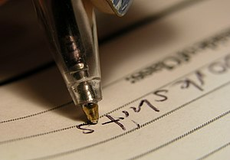
Stages of Handwriting
Stage Two – 2 or 3 weekly sessions totalling 30 to 45 minutes covering
Gross and fine motor skills exercises
Cursive handwriting reinforcement, learning and practice
Numerals, capitals and printed letters - where and when to use them
The children will use both their Literacy and Handwriting books for writing practice

Slide 6
Stages of Handwriting
Stage Three – 2 or 3 weekly sessions totalling 30 to 45 minutes covering
More advanced handwriting techniques
Cursive handwriting re-enforcement
Form-filling/labelling using printed and capital letters
Dictation exercises to teach the need for quick notes and speedy handwriting writing

Slide 7
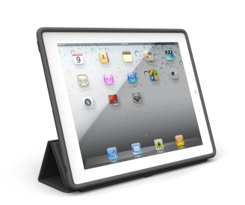
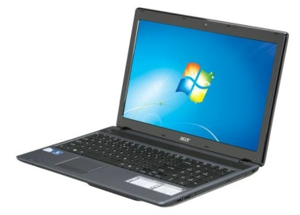
How can parents help at home?
www.letterjoin.co.uk
On a laptop - User name vt5749
Account Password: home
On an Ipad or Android tablet – vt5749 then draw a capital 'L' shape starting at top left
Select your child’s class
Select letters/words to watch being written and then practise writing on paper or on screen

